Slide 1

ChatGPT Twitter Dataset
Thomas Antony

Slide 2

Introduction
This project explores the classification of sentiments expressed in tweets using advanced machine learning techniques. The primary goal is to gain insights into how users perceive specific topics by analyzing their sentiments, categorized into Positive, Neutral, and Negative. By preprocessing raw tweet data and employing various machine learning models, this project demonstrates the ability to automate sentiment detection effectively.
Through a combination of data cleaning, feature extraction, and classification algorithms, this work provides a comprehensive pipeline for sentiment analysis. The project highlights the use of state-of-the-art models like XGBoost, comparing their performances against baseline methods like Logistic Regression.

Slide 3
The Dataset
Kaggle’s Dataset ChatGPT Sentiment Analysis uses data gathered to analyze the sentiment and opinions expressed in text, helping understand user perceptions and emotions associated with AI-driven conversational platforms like ChatGPT.
This dataset consists of 2 features and contains 219,295 unique values.
This file contains two columns: one for tweets and the other for labels.

Slide 4
Data Preprocessing
Effective data preprocessing was a critical step in ensuring the dataset was ready for analysis. The raw tweet data was first cleaned to remove unnecessary characters such as punctuation, special symbols, and links. Non-English tweets were filtered out to maintain consistency and focus on English text analysis. Emojis and hashtags were also stripped, as they could introduce noise into the data. Additionally, duplicate tweets and irrelevant data were removed to reduce redundancy and ensure high-quality input.
Sentiments were encoded as Negative = 0, Neutral = 1, and Positive = 2. Text data was vectorized using TF-IDF, highlighting key words and ensuring the dataset was ready for modeling.

Slide 5
Logistic Regression
Logistic Regression was the baseline model used in this project. It offers a simple and interpretable approach to classification problems, making it a good starting point for sentiment analysis.
Key Features:
Models linear relationships between features and target labels.
Easy to implement and requires minimal computation.
Acts as a benchmark for evaluating more complex models.

Slide 6
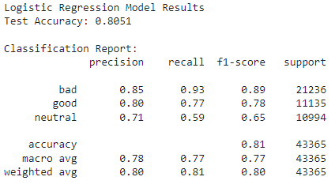

Slide 7
Decision Tree
Decision Trees provide an intuitive way to model data by splitting it based on feature thresholds. This model effectively handles non-linear relationships but is prone to overfitting without proper regularization.
Key Features:
High interpretability through decision paths.
Captures complex patterns in text data.

Slide 8
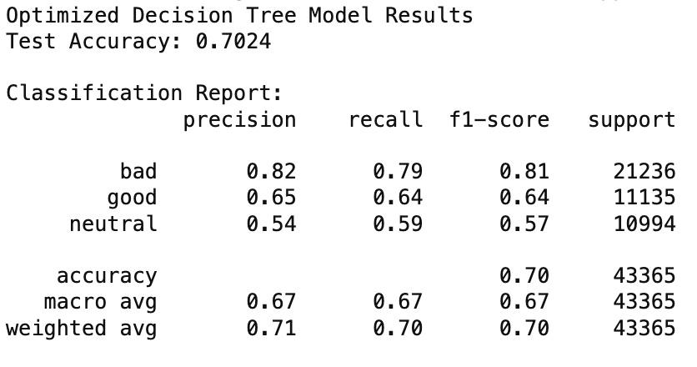

Slide 9
Random Forest
Random Forest is an ensemble method that combines multiple decision trees to create a more robust model. By averaging predictions, it mitigates the risk of overfitting and improves overall accuracy.
Key Features:
Robust against noisy data.
Handles missing values effectively.
Provides feature importance metrics for analysis.

Slide 10
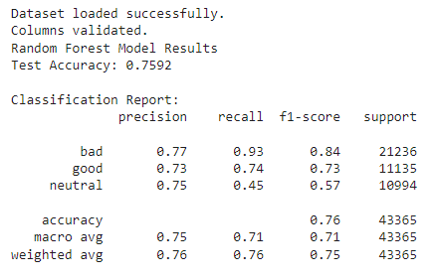

Slide 11
XGBoost
XGBoost, or Extreme Gradient Boosting, is an advanced ensemble learning technique that builds decision trees sequentially to optimize classification performance.
Key Features:
Efficient handling of sparse, high-dimensional data.
Built-in regularization to prevent overfitting.
Highly scalable with parallel computation support.

Slide 12
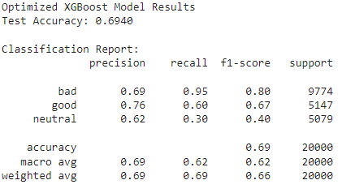

Slide 13
Adaboost
AdaBoost is an ensemble learning method that combines multiple weak classifiers to create a strong classifier by iteratively focusing on the misclassified samples. The model adjusts its weights on the training data, giving higher importance to misclassified points in subsequent iterations.
Key Features:
Builds multiple weak classifiers (e.g., Decision Stumps) sequentially.
Misclassified samples receive higher weights in the next iteration to improve prediction accuracy.
Boosting approach reduces bias and variance, making it effective for moderately complex datasets.

Slide 14
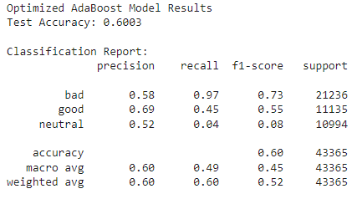

Slide 15
Word2Vec for Text Representation
Word2Vec, a neural network-based approach, was used to generate dense vector representations of words in tweets. These embeddings captured semantic similarities between words, enriching the feature space for machine learning models.
Key Features:
Transforms words into continuous vector space.
Two approaches: Continuous Bag of Words (CBOW) and Skip-gram.
Represents each tweet as an average of its word vectors.

Slide 16
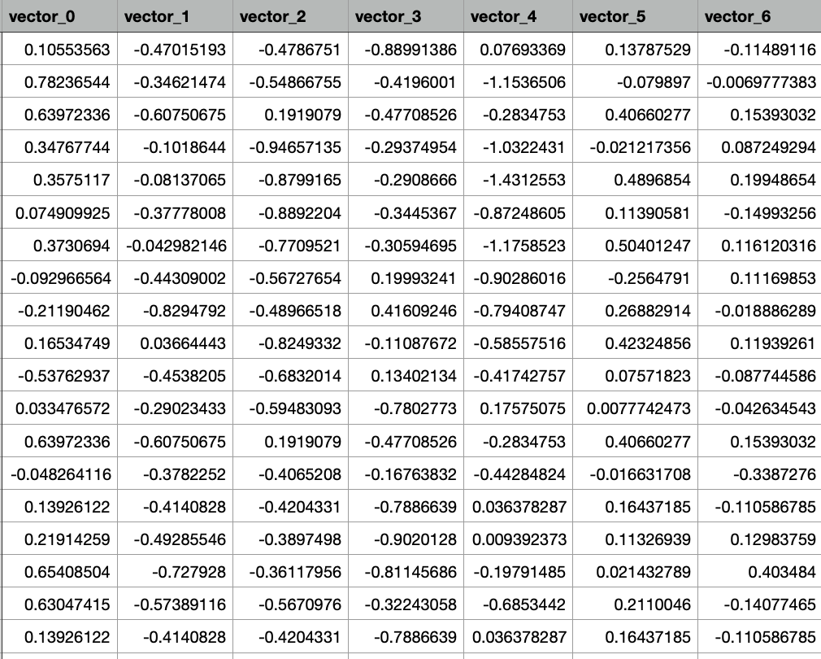

Slide 17
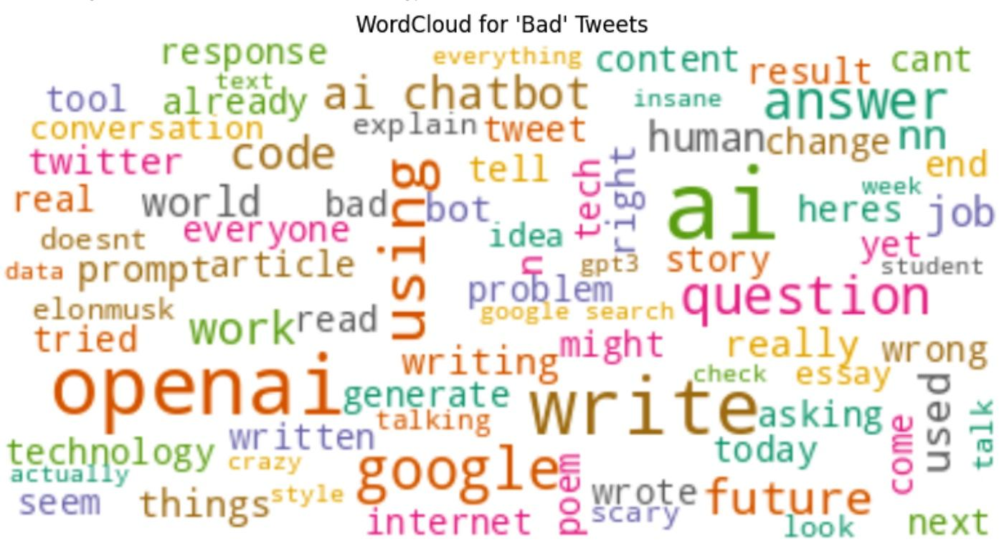
Wordclouds
Word clouds were generated to visualize the most frequently occurring terms for each sentiment category. This helped identify the key themes and words associated with positive, neutral, and negative sentiments.
These word clouds provided an intuitive way to understand the dominant terms in each sentiment category.

Slide 18
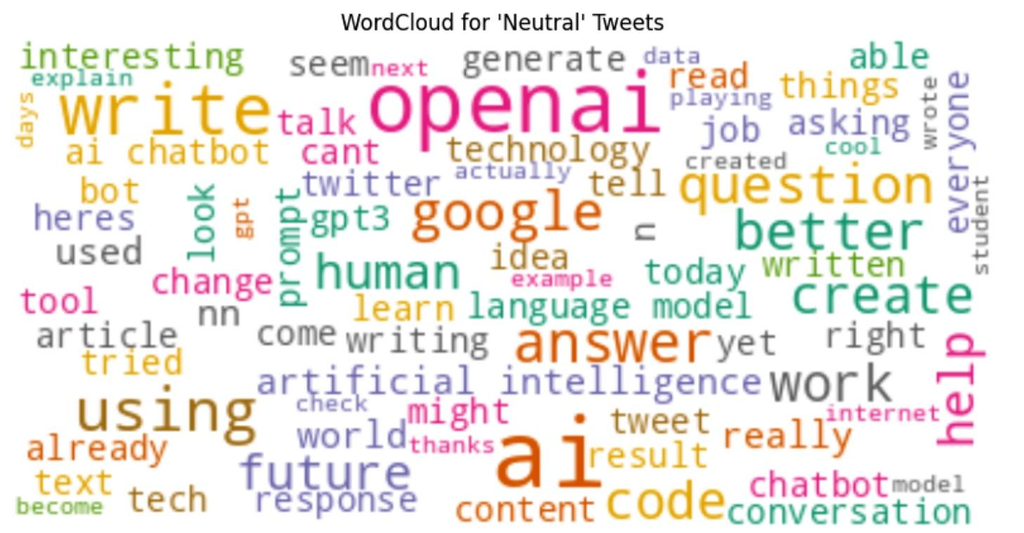
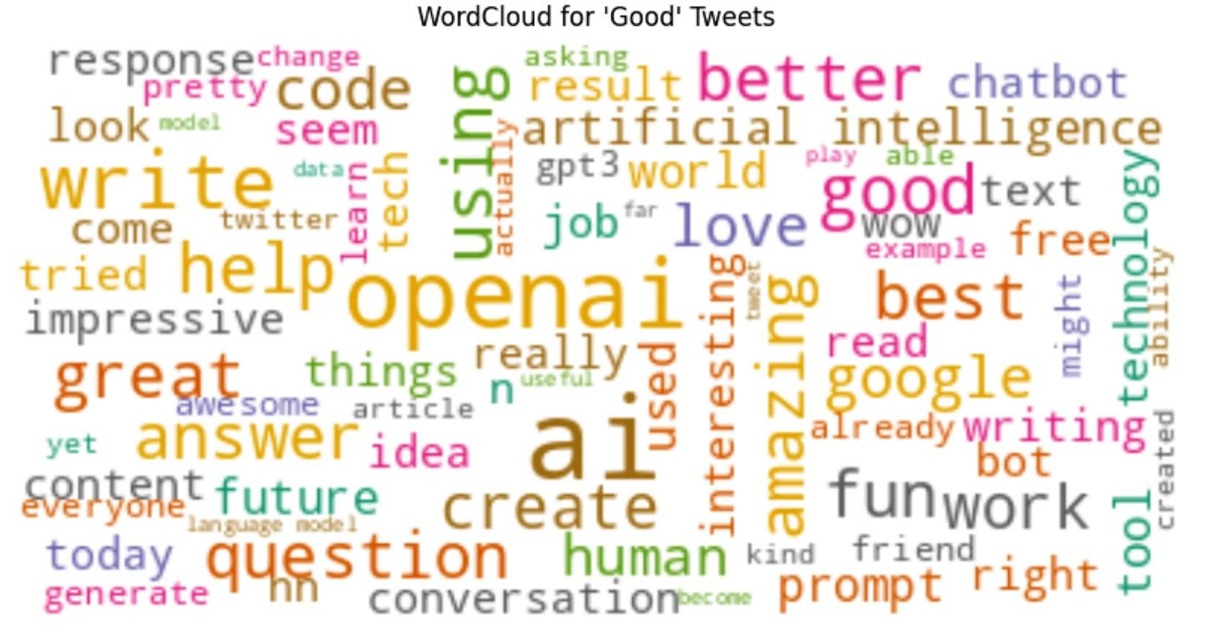

Slide 19
Conclusion
This project demonstrated the effectiveness of machine learning models in sentiment analysis, successfully classifying tweets into Positive, Neutral, and Negative categories. Through a systematic approach of data preprocessing, feature engineering, and evaluation of multiple models, the study provided meaningful insights into public sentiments and their underlying themes.

